Slide 1


DATA STRUCTURES
USING “C”
Lecture 1

Slide 2

Today’s Agenda
Prerequisites Of The Course
What Is Data Structure And Why It Is So Important ?
Data Structures V/s Algorithm
Examples Of Data Structure And Algorithm In Real Life
Types Of Data Structure
Why Companies Ask Data Structures ?
Course Outline

Slide 3
Prerequisites
To learn and implement Data Structures we need:
Knowledge Of Any One Programming Language
We will use C in this course
No knowledge of C++ needed
Topics Of C Required:
Functions
Pointers
Structures
Strings

Slide 4
What Is Data Structure ?
Data Structure is a way of storing and organising the data in computer’s memory in such a way that we can perform operations on these data in an effective way.
To understand this more clearly , lets’ take a simple non technical example , shown in the next slide

Slide 5

What Is Data Structure ?
Given a basket of fruits and vegetables , how would you find/search apples and oranges in it ?
As you can observe , since the basket is unorganized , it seems to be very difficult for us to find our items.

Slide 6

What Is Data Structure ?
Now have a look at the arrangement of fruits and vegetables shown below and think again about the task?
As you can observe , since the food items are now organized , it seems to be very easy for us to find our items.

Slide 7
What Is Data Structure ?
So , what we have done in the second way ?
We have simply taken fruits and vegetables from the first messy basket and organized them in a proper way .

Slide 8
What Is Data Structure ?
The same concept applies to data structures .
Here also we are given some data and we have to do some processing on it.
So before processing the data we organize this data in such a way that we can easily access/ process/operate on this data.

Slide 9
What Is An Algorithm?
An Algorithm is a set of rules to follow to solve a particular problem.
Example: Suppose we want to prepare SALAD for lunch.

Slide 10


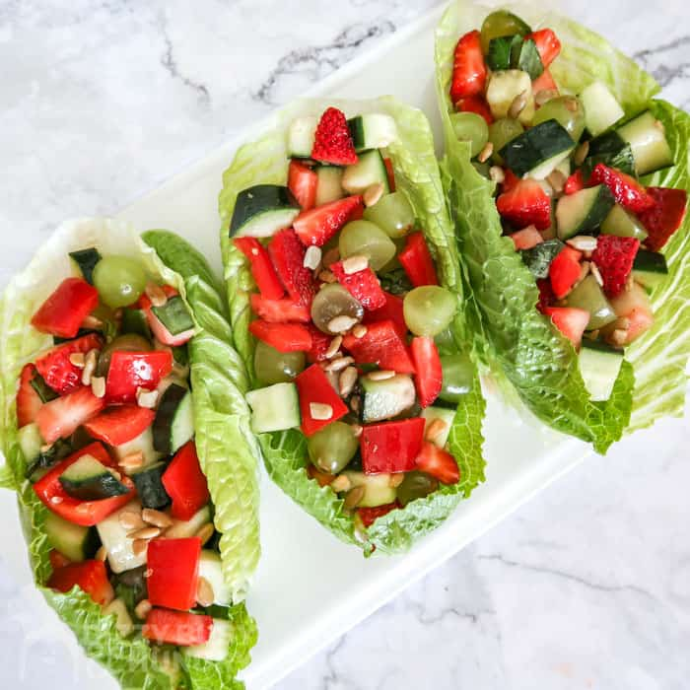


What Is An Algorithm?
STEPS or SET OF RULES TO SOLVE A PROBLEM

Slide 11
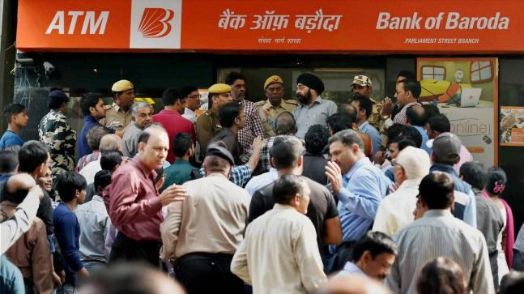
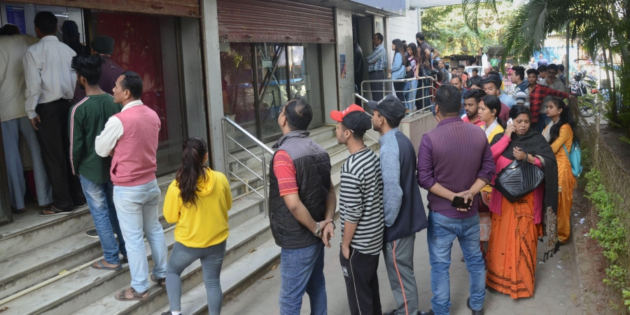
Examples Of DS In Real Life
People at ATM for cash withdrawal
Impossible to operate the ATM
Very manageable , as people are in a QUEUE

Slide 12
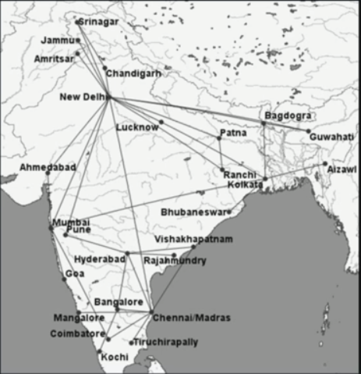
Examples Of DS In Real Life
Air Connectivity Map Of India
Suppose we need to go to
Coimbatore from Delhi.
Very difficult to calculate
the OPTIMUM PATH
manually
Very easy if we convert it
Into a GRAPH and use
SHORTEST PATH

Slide 13
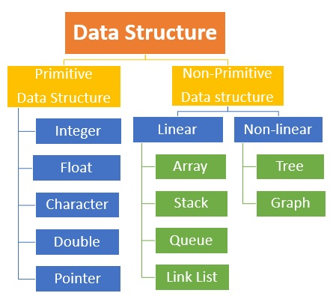
Types Of Data Structure

Slide 14
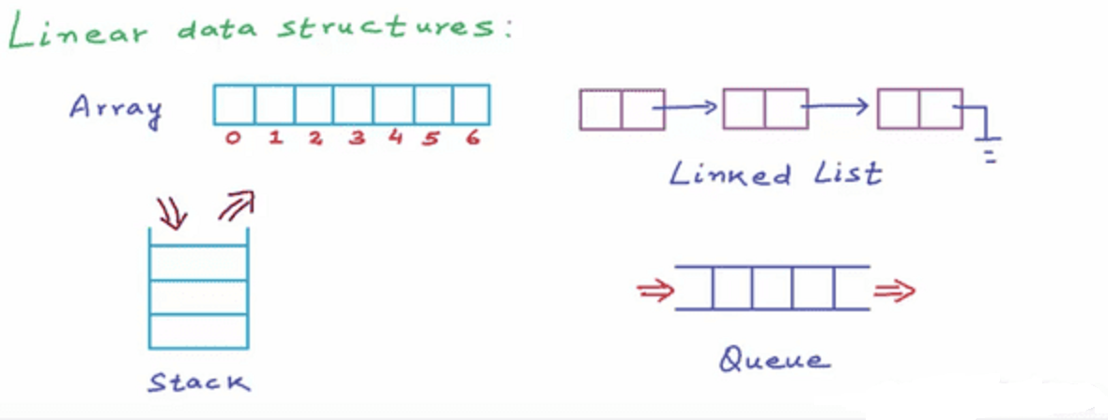
Linear V/s Non Linear
A data structure is said to be Linear if its elements are connected in a sequential manner by means of logically or in sequence memory locations.

Slide 15
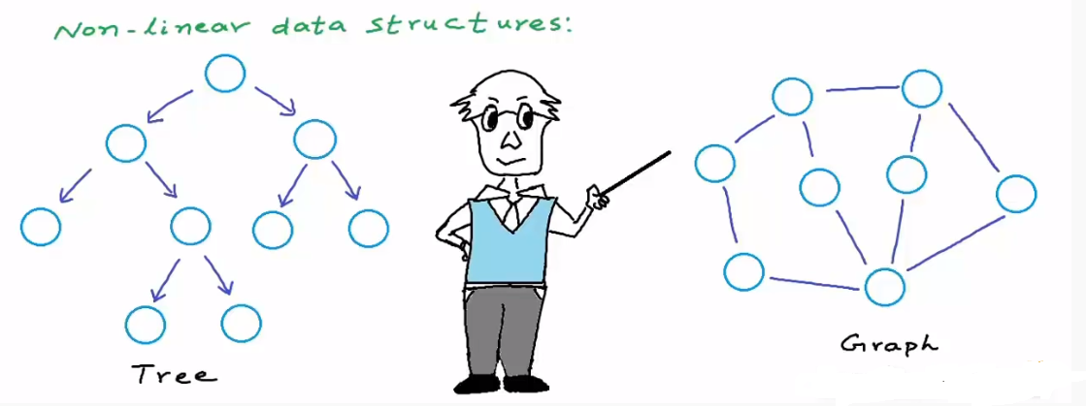
Linear V/s Non Linear
Nonlinear data structures are those data structure in which data items are not arranged in a sequence.

Slide 16
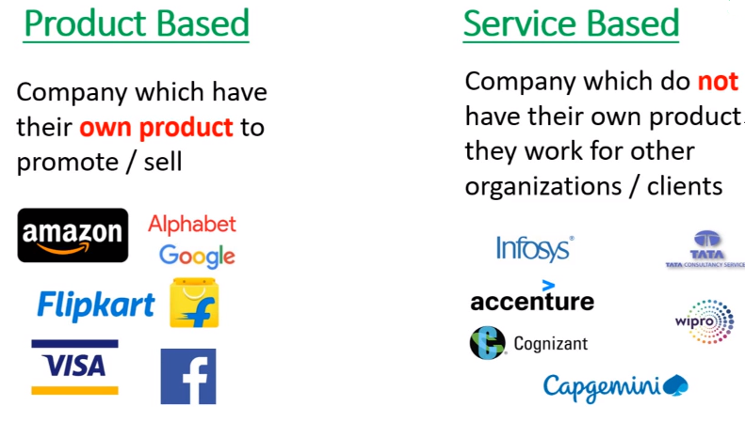
Types Of IT Companies

Slide 17
Why Companies Ask Data Structures ?
Data structures and algorithms play a major role in implementing software and in the hiring process as well.
If we want to test a person on how smart he is, how good he is at solving problems, and how quickly he can pick up new technologies., then it is very difficult to test it in an hour, so DSA questions are used as a SELECTION CRITERIA.
Every PRODUCT BASED COMPANY focuses on DSA as they want people who can think out of the box to design algorithms that can save the company thousands of dollars

Slide 18
Course Outline
STACK
Introduction To Stack
Where Stack Is Used ?
Stack Operations : PUSH , POP, PEEP
Implementing Stack In C Language
Applications Of Stack
Converting INFIX to POSTFIX and PREFIX
Evaluating INFIX

Slide 19
Course Outline
QUEUE
Introduction To Queue
Linear Queue
Drawbacks Of Linear Queue
Circular Queue
Priority Queue
Dynamic Queue
Applications Of Queue

Slide 20
Course Outline
LINKED LIST
Introduction To Linked List
Static V/s Dynamic Allocation
Why We Need A Linked List ? ( Drawbacks Of Array)
Linear Linked List
Implementation
Adding , Searching , Displaying Nodes Of A Linked List
Remove Nodes From A Linked List

Slide 21
Course Outline
CIRCULAR LINKED LIST
Introduction To Circular Linked List
Why We Need A Circular Linked List ?
Implementation
Adding , Searching , Displaying Nodes Of A Circular Linked List
Remove Nodes From A Circular Linked List
Various Interview Problems On Circular And Linear Linked List
Polynomial Representation Using Linked List

Slide 22
Course Outline
DOUBLY LINKED LIST
Introduction To Doubly Linked List
Why We Need A Doubly Linked List ?
Implementation
Adding , Searching , Displaying Nodes Of A Doubly Linked List
Remove Nodes From A Circular Linked List
Various Interview Problems On Doubly Linked List
Linked Implementation Of Stack & Queue

Slide 23
Course Outline
TREE
Introduction To Tree
Why We Need Tree ?
Understanding Binary Tree
Types Of Binary Tree
Different Types Of Binary Tree
Different Ways Of Representing Binary Tree In Memory
Creating A BST

Slide 24
Course Outline
TREE OPERATIONS
Introduction To Tree Traversal
Preorder , Inorder and Postorder Traversal
Implementing Tree Traversal
Deletion In A Binary Tree
Introduction To Heap
Different Operations On Heap
Introduction To AVL Tree

Slide 25
Course Outline
AVL, B-Tree & TBT
Rotations In An AVL Tree
Code For AVL Tree
Multiway Search Tree
What Is A B-Tree ?
Creating A B-Tree
Threaded Binary Tree
Different Operations On A Threaded Binary Tree

Slide 26
Course Outline
GRAPH
Introduction To Graph
What & Why Of Graph
Graph Terminologies
Graph Representations : Adjacency Matrix & Adjacency List
Graph Traversals: BFS & DFS
Single Pair & All Pair Shortest Path
Spanning Tree

Slide 27
Course Outline
RECURSION
Introduction To Recursion
Why Recursion Is Important ?
Recursion V/s Iteration
How Recursion Works Internally ?
Examples Of Recursion
Types Of Recursion
When To Use/Avoid Recursion ?

Slide 28
Course Outline
COMPLEXITY ANALYSIS
Algorithm Runtime Complexity Analysis
Why Analysis Is Important ?
Types Of Complexity Analysis
How To Calculate Complexity Of An Algorithm ?

Slide 29
Course Outline
SEARCHING & SORTING
Searching
Linear & Binary Search
Sorting
Bubble Sort, Insertion Sort, Selection Sort
Quick Sort, Heap Sort, Merge Sort
Why So Many Sorting Techniques Are There ?

Slide 30
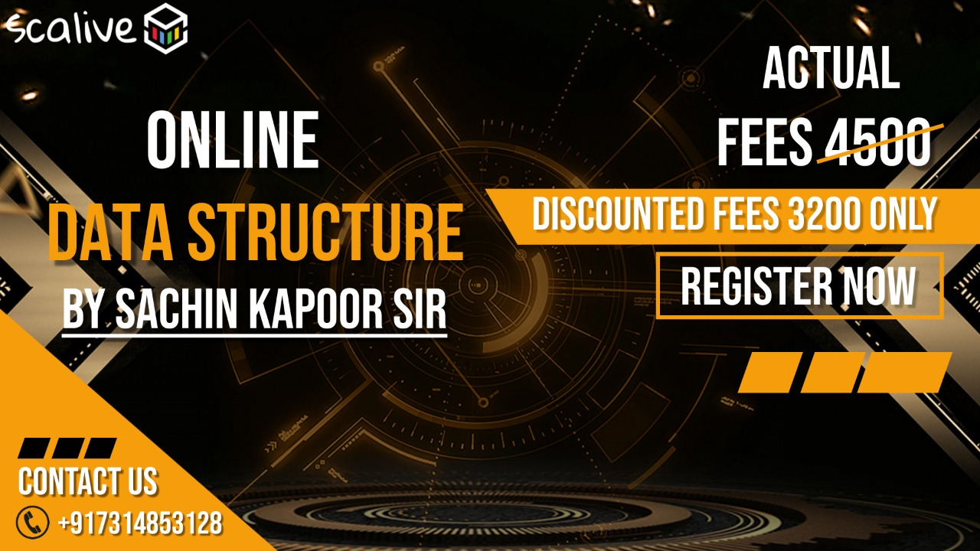
Course Fee

Slide 31
Next Class. . .
Next class will be on Saturday , 29th Jan @ 7:00 PM
For any query ,please feel free to call at :
7314853128
7870554215
9826686245

